Slide 1




2021 FinAccess Household Survey:
Key Findings

Slide 2
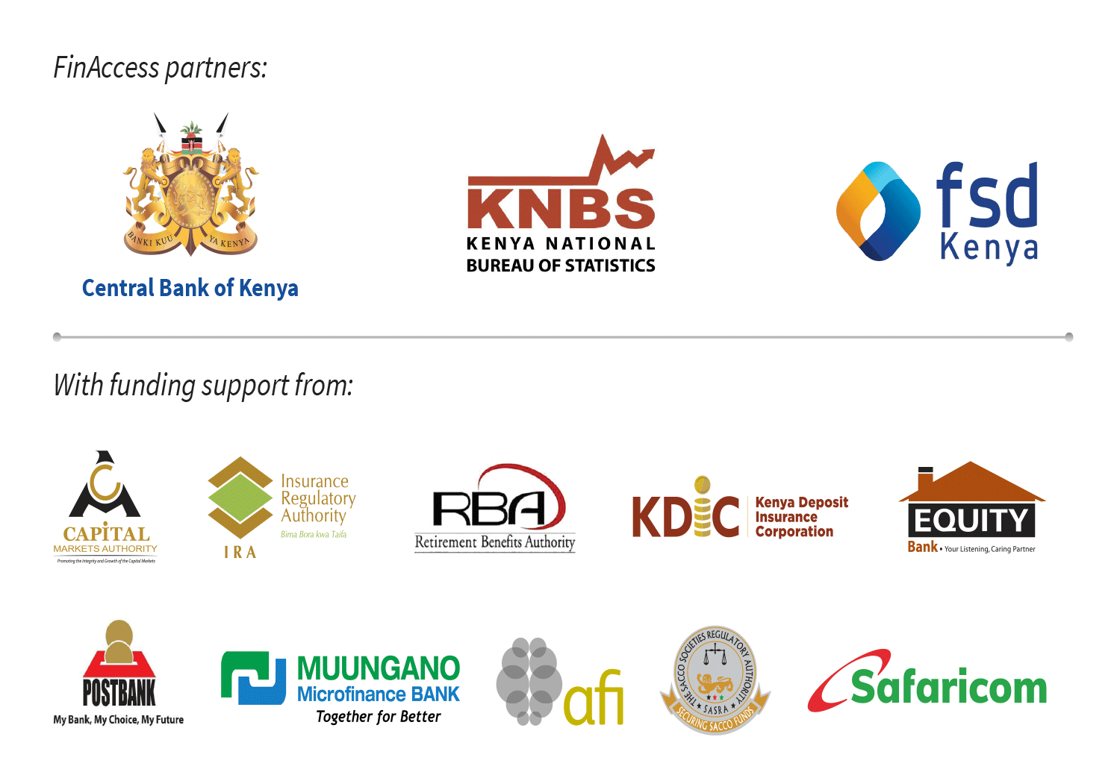

Slide 3
Presentation Flow
Summary and Conclusions
Key Findings
Questions and Answers Session
Introduction
Notes:
FinAccess surveys tracking progress towards financial inclusion in Kenya have been regularly conducted since 2006
The 2016 survey is the fourth, spanning ten years of financial sector development in Kenya
Not only does the survey provide an Empirical basis to track progress on financial inclusion in Kenya. It also
Provides information to the private sector about market opportunities
Provides information to policy makers about the main barriers to access, and options for reforms
Provides data for Academic research into impact on growth and poverty reduction

Slide 4
INTRODUCTION
Survey Methodology, Sample, Demographics and Survey Administration

Slide 5
Methodology
The 2021 FinAccess is a cross-sectional survey undertaken to provide indicators on financial inclusion from four measurement dimensions:
Access;
Usage;
Quality; and
Impact/Welfare
Targeted persons aged 16 years and above living within conventional households in Kenya at the time of data collection
Interviewees selected randomly

Slide 6
Survey Sample
Study domains used: 50 i.e. National; Rural, Urban; and 47 Counties
Sample size: 30,600 households
Used the newly created Kenya Household Master Sample Frame (K-HMSF) based on the 2019 Kenya Population and Housing Census data
Overall response rate: 85.6 percent

Slide 7
Survey Demographics
Fig.: Response rates
Fig.: Age Distribution
RESULTS | RESIDENCE
 | RURAL | URBAN | TOTAL
Selected Households | 18,774 | 11,826 | 30,600
Eligible Households | 16,316 | 9,408 | 25,724
Households Interviewed | 14,455 | 7,569 | 22,024
Response Rate (%) | 88.6 | 80.5 | 85.6

Slide 8
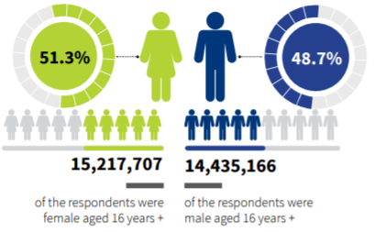
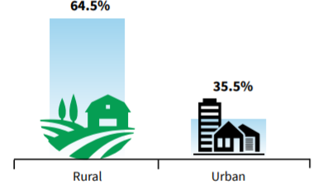
Survey Demographics
Fig.: Population by Sex
Fig.: Population by Residence

Slide 9
Survey Administration
The survey used Computer Aided Personal Interview (CAPI) through face-to-face interviews;
in English, and translations in several local languages,
with Kiswahili being the most preferred interview language
KNBS cleaned and weighted the data to total population,
representing those aged 16+ years

Slide 10
Key findings
Access Usage Quality Impact

Slide 11
Expanding Access

Slide 12
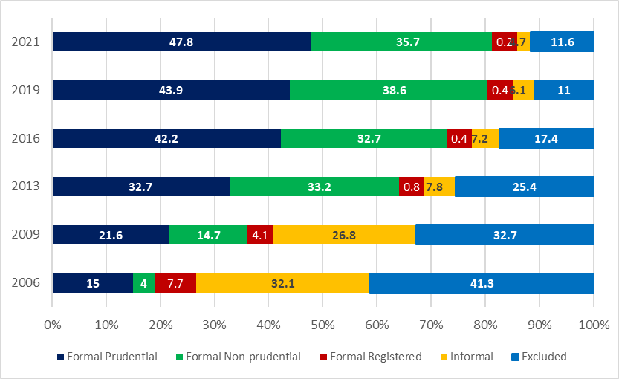
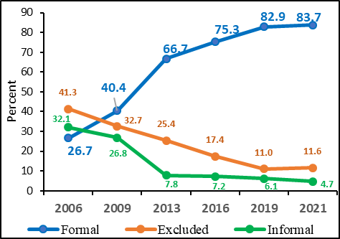
Access to formal financial services providers rose to 83.7 % in 2021 but those accessing informal providers declined further. The excluded population was11.6% in 2021 from 11% in 2019
Fig.: Access Trends – 2006:2021
Fig.: Access by Categories
Overall access levels

Slide 13
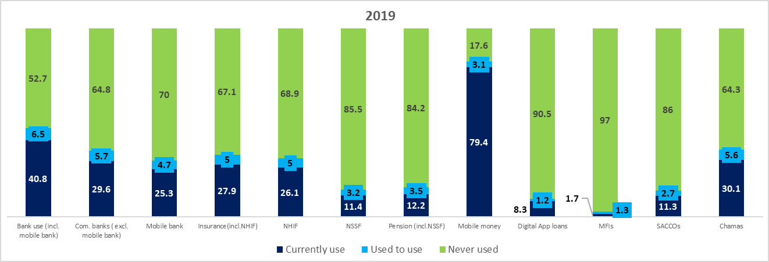
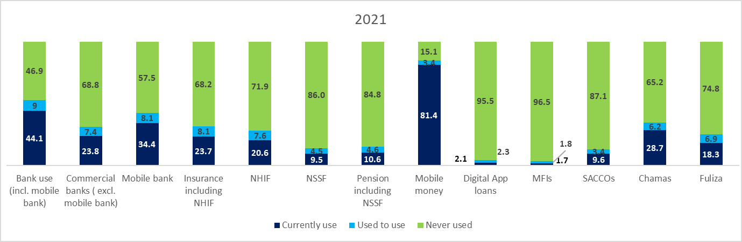
Overall, number of those who Used to Have certain products/services increased in 2021 compared to 2019

Slide 14
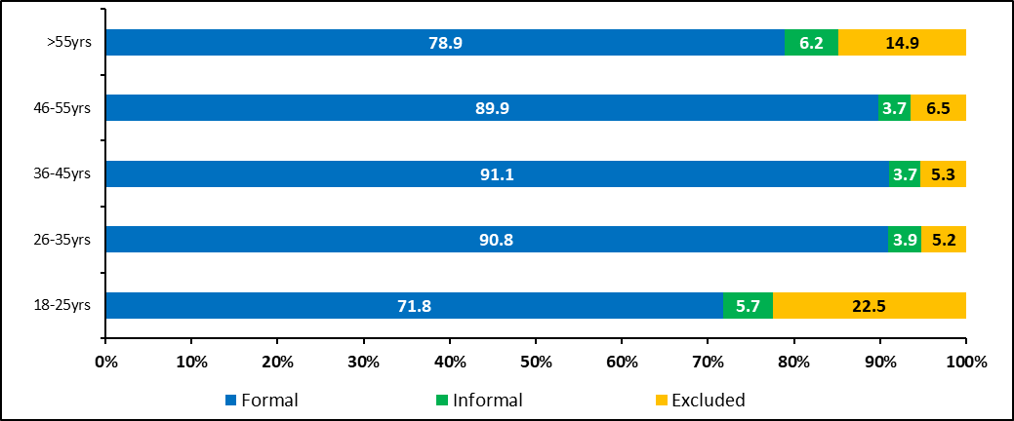
Fig.: Exclusion Rates by Age in 2021 (Percent)
Youths and the elderly above 55 years largely explain increased exclusion rate. Those aged 18–25 years most excluded at 22.5% in 2021, up from 18.2% exclusion rate in 2019.

Slide 15
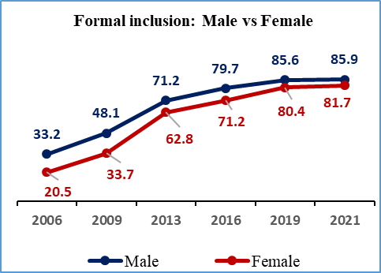
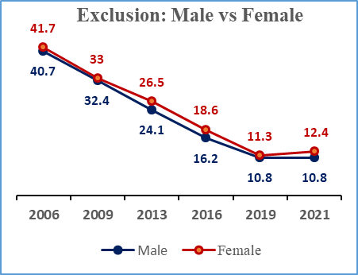
Fig.: Included Vs Excluded by Sex (Percent)
The gap between male and female improved to 4.2% in 2021 from 8.5 percent in 2016, implying rising equality among the two genders in terms of formal inclusion.

Slide 16
Fig: Slow Growth of Mobile Money Uptake
Slow growth in mobile money uptake - only by 2 percentage points growth in 2021–2019 compared to 33.7 percentage points in 2013–2009. May explain overall slow growth in inclusion
Survey Year | Uptake (Percent) | Change in Percentage Point
2006 | Base year | Base year
2009 | 27.9 | 27.9
2013 | 61.6 | 33.7
2016 | 71.4 | 9.8
2019 | 79.4 | 8
2021 | 81.4 | 2

Slide 17
Fig.: Exclusion by Demographics
In addition, income disparities (measured by wealth quintiles), age, and residence appear to explain the marginal uptick in exclusion rate in 2021.

Slide 18
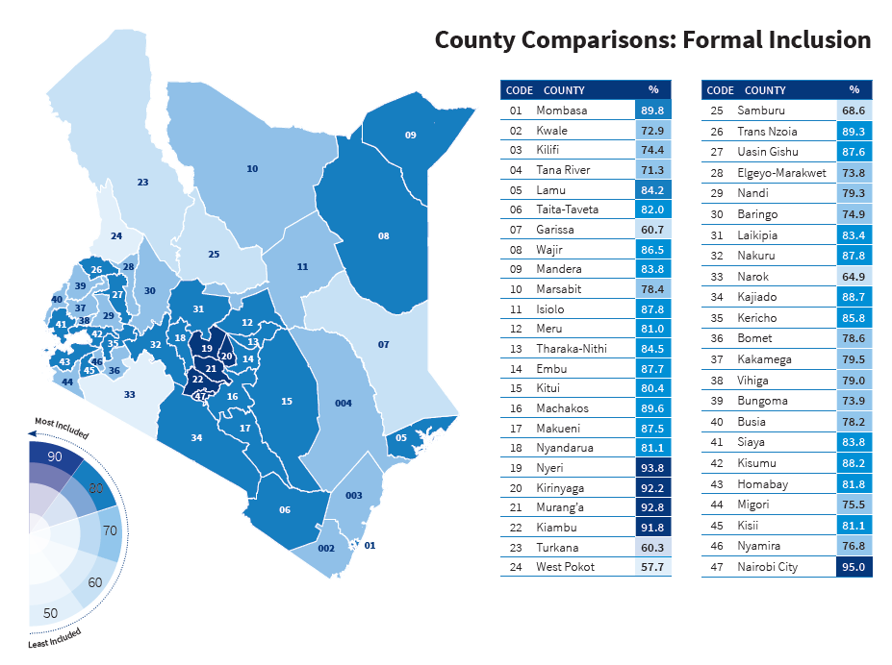
Significant variation in formal financial access across counties
Formal inclusion by County

Slide 19
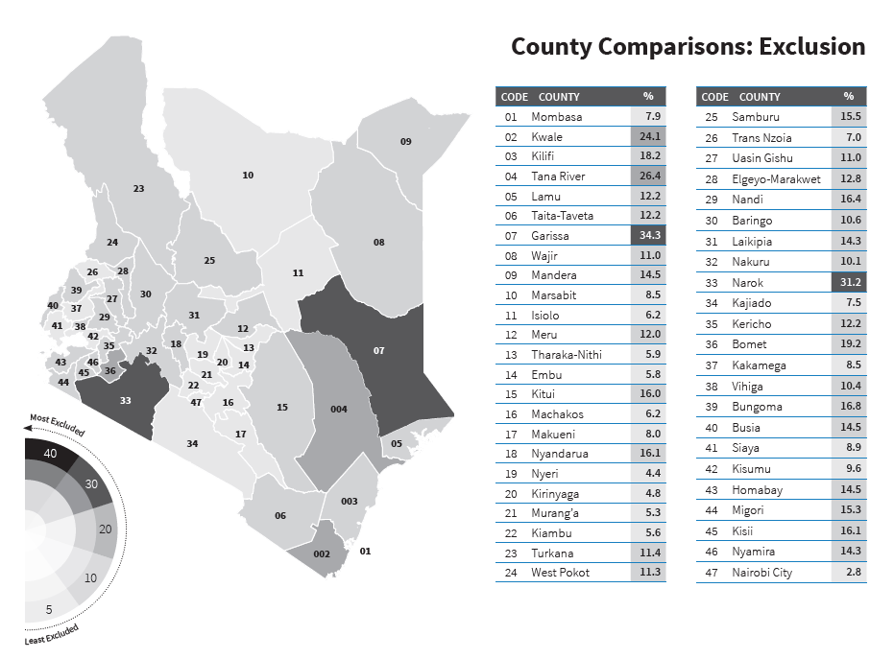
Financial exclusion is determined by various socio-economic factors?
Exclusion levels by County

Slide 20
Deepening Usage: Providers, Services and Products
We are interested in measuring;
How frequent people actually use these providers, services or products
How long (duration) people take using these financial providers, services and products
Reasons for use or non-use of certain providers, services or products
We analyse the providers, products and services along key demographic indicators - age, sex, education, residence, wealth quintile and County
Since the respondents use these providers and products in multiples, proportions of usage are not additive

Slide 21
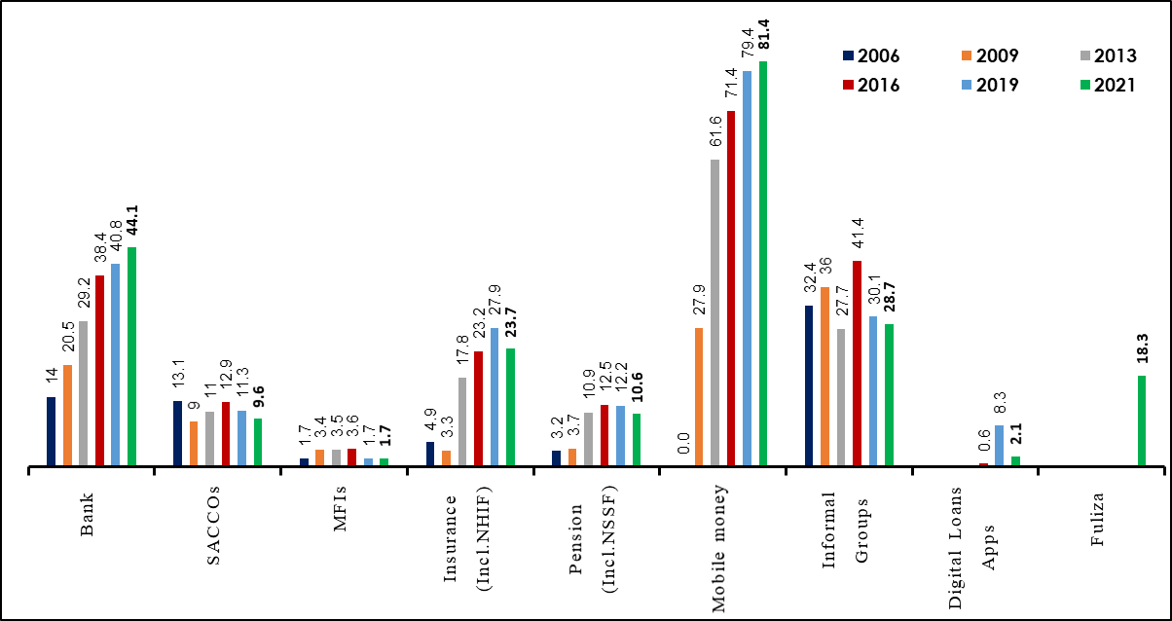
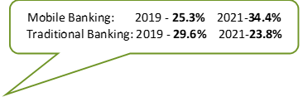
Mobile money and mobile banking usage including Fuliza are driving financial inclusion. Decline in Digital Apps Loans may reflect competition from the regulated digital credit providers and unfair debt collection practices that scare potential users .
Fig.: Usage of Financial Services and Products by Providers (Percent)
Usage of all the non-bank related providers declined in 2021, an area of deep dive research

Slide 22
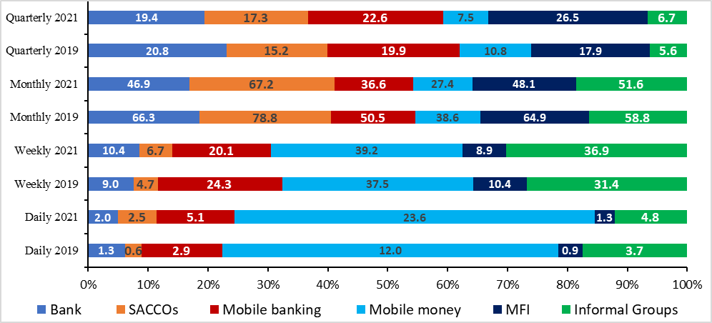
Increased frequency of mobile money and informal groups usage in 2021 may indicate increased liquidity needs, government policy to curb the spread of COVID-19 in 2020, and waiver of transaction charges
Fig.: Usage of Financial Providers by Frequency
Frequency of Usage

Slide 23
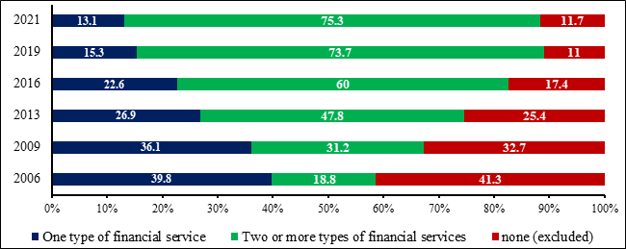
Consumers use a portfolio of financial providers, services and products in terms of formal and informal in order to meet their needs
Fig.: Usage by Combination of Financial services providers
More is preferred to less....

Slide 24
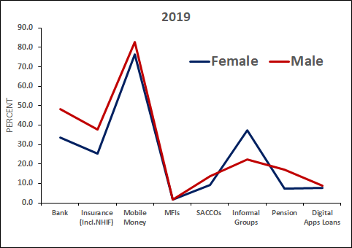
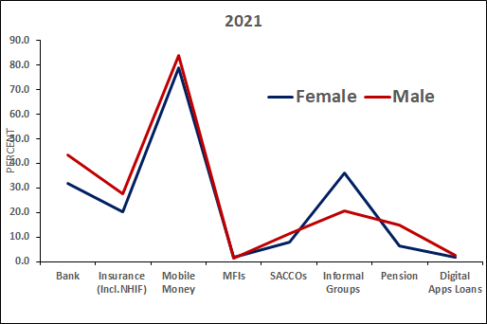
Mobile money including Fuliza usage continues to drive narrowing gap between male and female users…however more female than male use informal sources/products
Fig.: Usage of Financial Providers and Products by Sex
Frequency of Usage

Slide 25
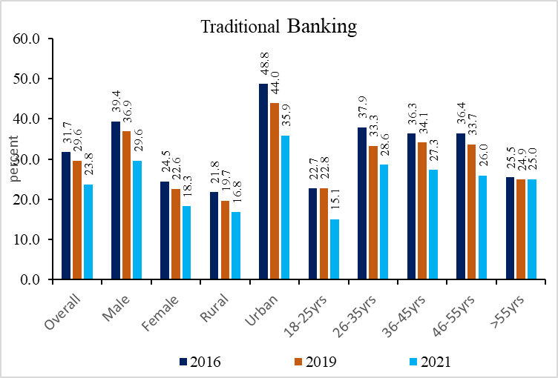
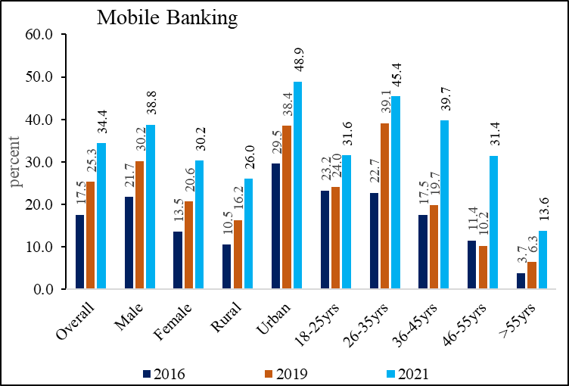
Traditional banking (brick and mortar) usage continue to decline since 2016 as more people embrace Mobile banking across all demographics
Female and rural residents adopting mobile banking faster – improved infrastructure (including cheaper smart phones), convenience,
Fig.: Traditional versus Mobile Banking Usage Overtime by Demographics

Slide 26
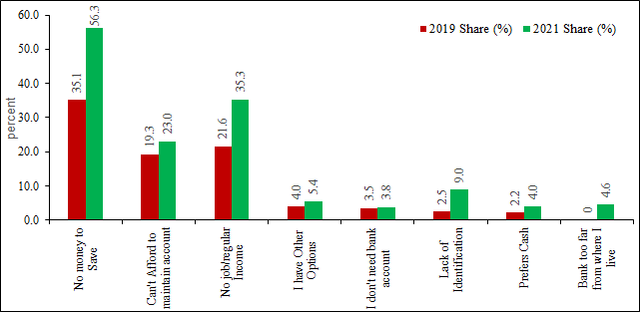
Lack of money to save, no regular income and high cost of operating a bank account cited as main reasons why people have not used bank account in the last 12 months prior to the survey
Fig.: Reasons for Not Using Bank Account
Savings vs Credit Usage

Slide 27
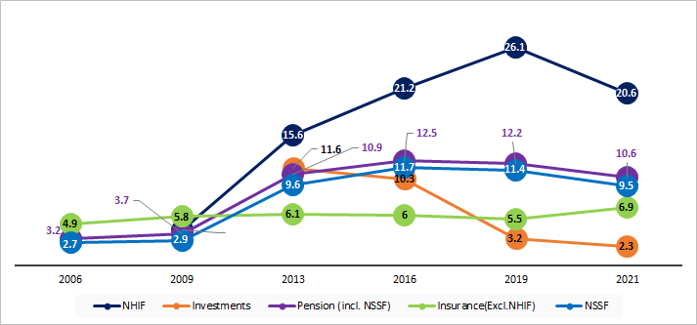
Actual usage of all non-bank financial providers, services and products, except for Insurance regulated by IRA, declined in 2021. Even the use of NHIF declined despite the recent initiatives – may be due to COVID-19 related restrictions and their impact
Fig.: Insurance, Pension and Investments Usage
Insurance, Pension and Investments Trends

Slide 28
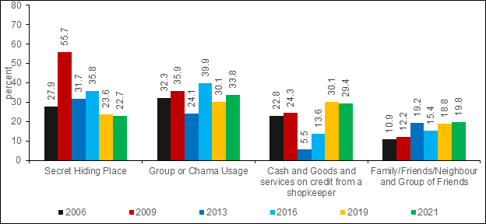
Usage of Chamas/Groups and Family/Neighbours/ friends increased in 2021, highlighting the important role of social networks in financial inclusion at household level
Use of secret hiding places and shopkeepers declined marginally
Fig: Breakdown in Informal Group over time

Slide 29
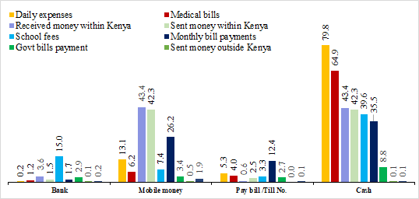
Use of Cash followed by mobile money dominate all transactions channels in 2021 compared to 2019
2019
2021

Slide 30
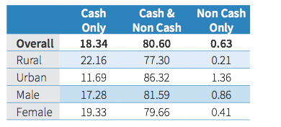
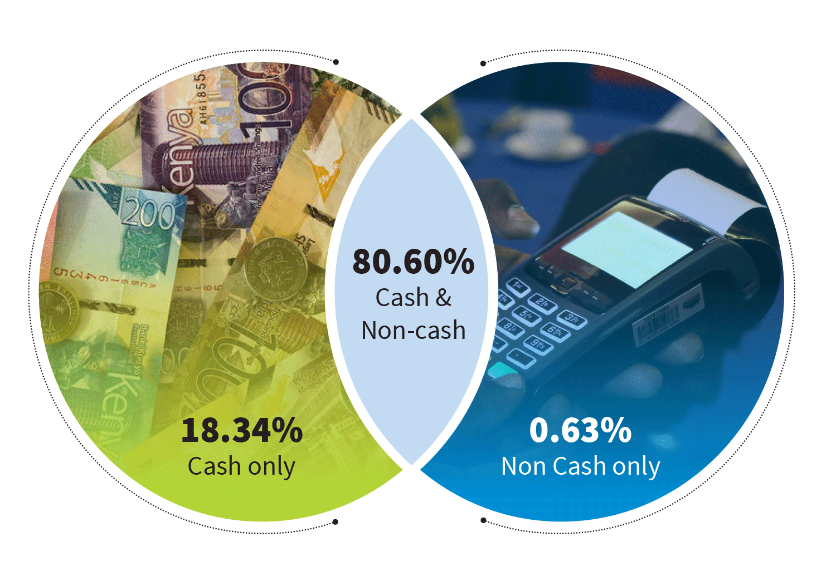
A majority of Kenyans use both cash and non-cash across all types of transactions. Exclusive use of non-cash quite marginal, at below 1 percent
The Questionnaire did not ask about cash limits. Proposal for a follow up tracker survey on digitization

Slide 31
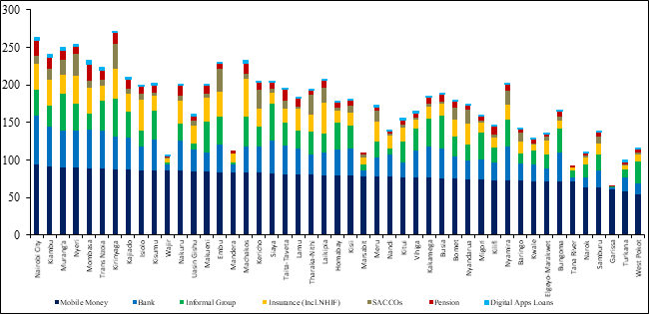
Mobile money usage is the equalizing factor across Counties by provider and product Usage of different providers seem to follow economic and socio-cultural orientation of counties
Usage of Financial Services and Products by County
Usage by County

Slide 32
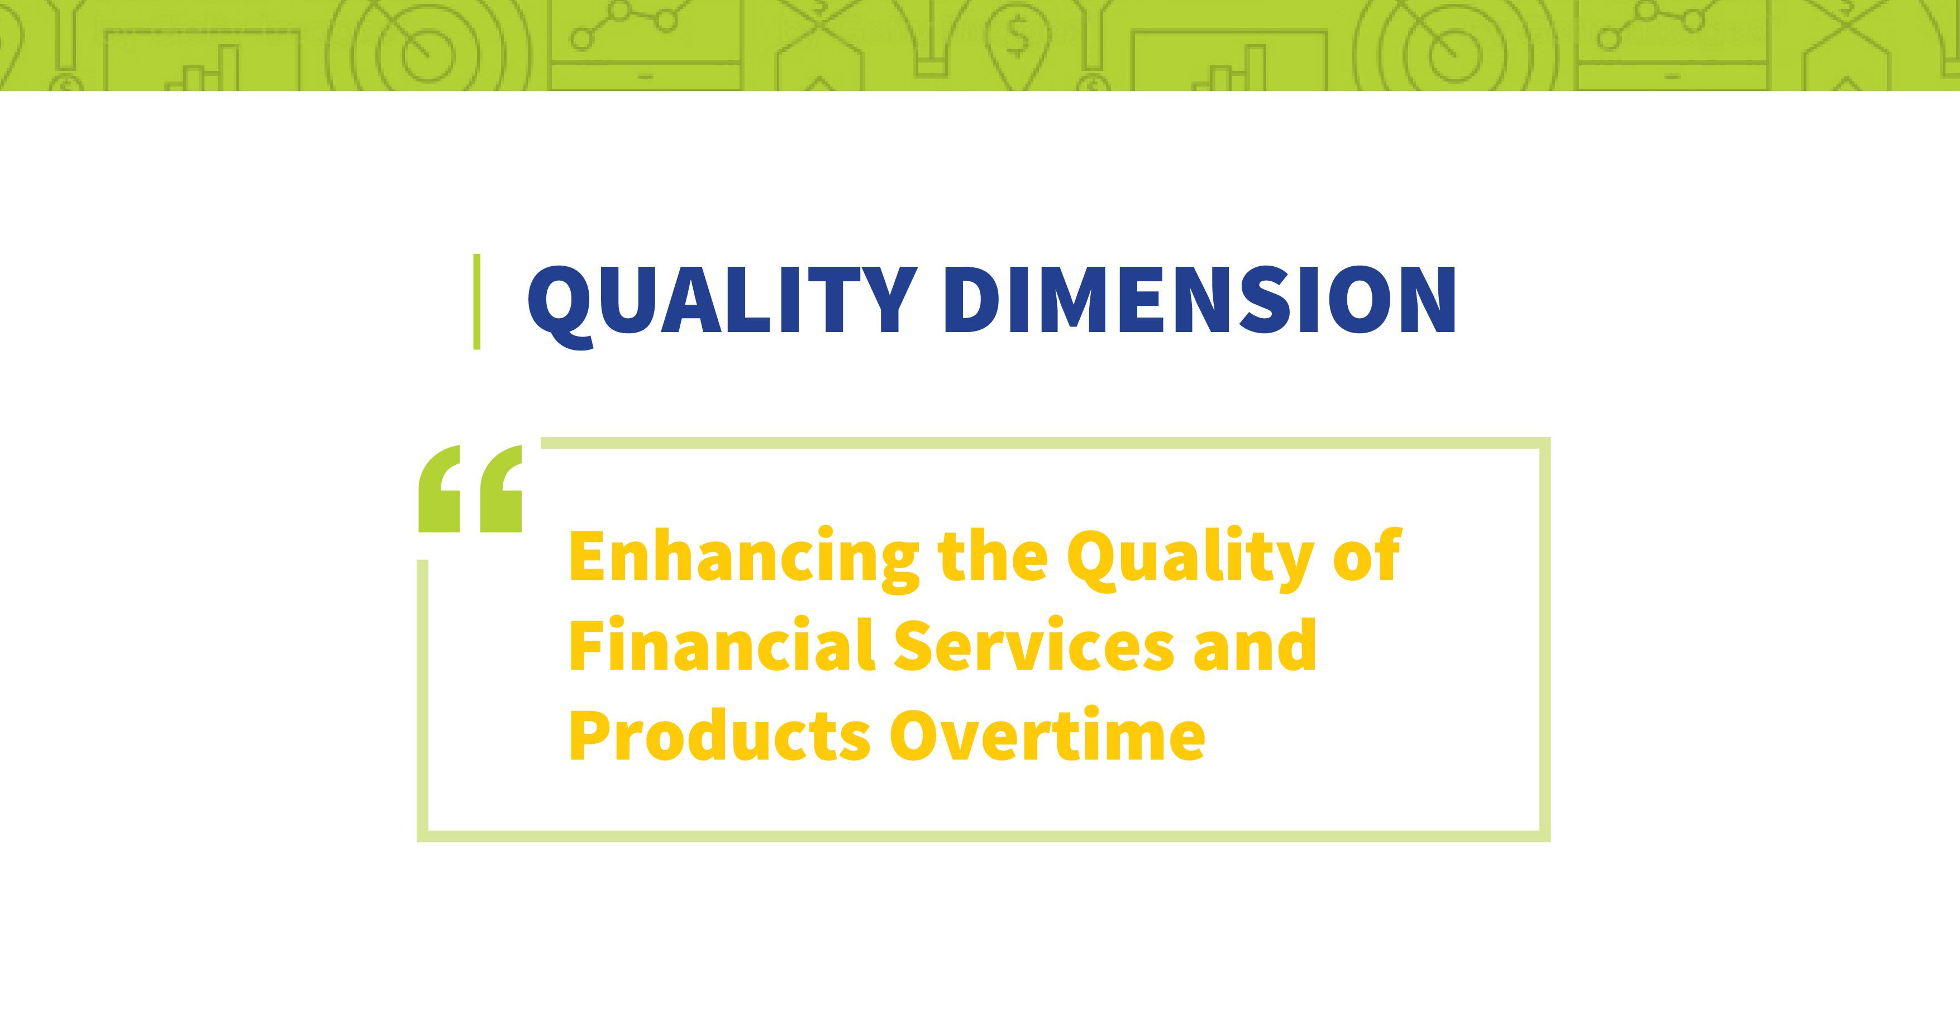

Slide 33
Theme: “Addressing quality concerns in the era of financial digitalisation and misinformation”
The objective is to measure whether the financial products and services match clients’ needs, the range of options available to customers, and clients’ awareness and understanding of financial products by focussing on financial literacy and consumer protection concerns.

Slide 34
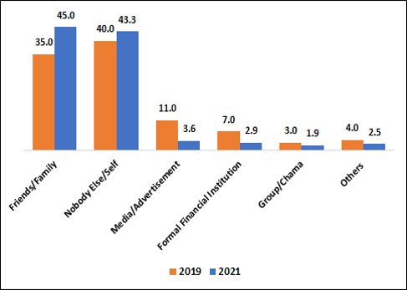
Financial Literacy
Majority of Kenyans seek financial advice from informal sources – family and friends and personal knowledge/experience
Fig.: Sources of financial advice (%)
45.0% of adults rely on friends and family for financial advice
43.3% rely on their own knowledge for financial advice

Slide 35
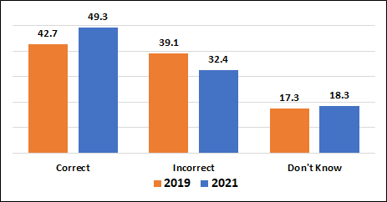
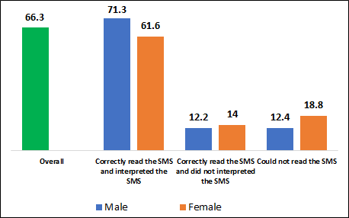
The survey tested the ability of respondents to accurately compute a 10 percent interest on a KSh 10,000 loan:
49.3% of the adult population got correct answer
66.3% correctly identified transaction costs on a mobile phone
Knowledge about Cost of Borrowing
Knowledge about Transaction costs

Slide 36
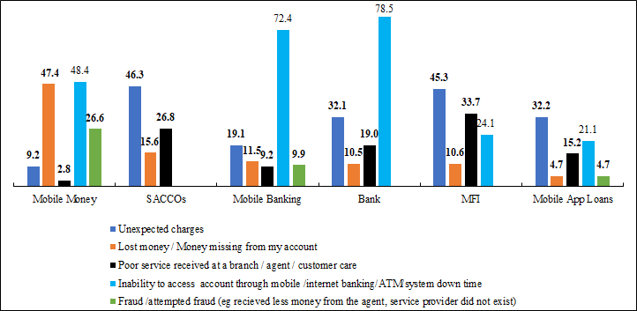
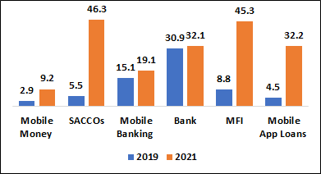
More respondents reported increased Unexpected/unclear charges in 2021 compared to 2019. Other major challenges: frequent system downtime, poor customer service and lost money from account
Fig.: Challenges cited by Consumers in 2021 by Provider (percent
Fig: Unexpected or unclear charges

Slide 37
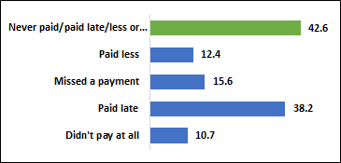
We also analyse the household indebtedness. We noted that debt distress is a major challenge affecting consumers in 2021, with 10.7% of borrowers completely defaulting (did not pay at all) on their loans
Fig.: Default by Type

Slide 38
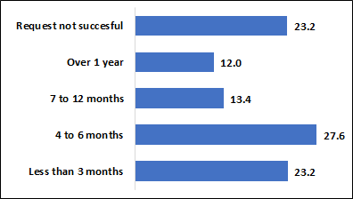
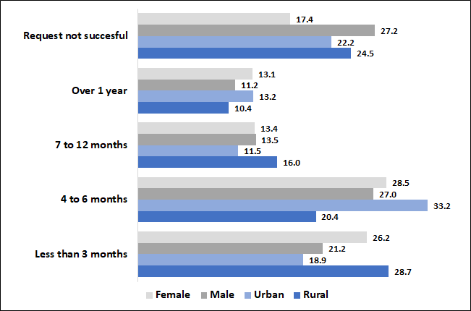
About 14.4% of respondents with existing loan from a bank, MFBs or SACCOs in 2020/201 applied for loan restructuring, with close 77 percent being successful
Requested for restructuring (b) Loans Were Restructured

Slide 39
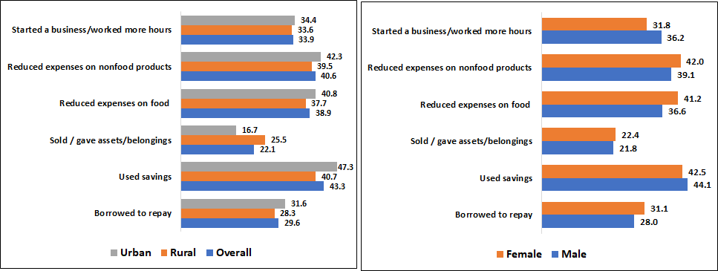
Strategies employed by households in debt repayment and resolving household indebtedness in 2021 ... Cut down on other expenses (food and non-food), ran down savings, looked for additional work/business and took another loan to repay
Fig.: Strategies Employed to Repay Debt

Slide 40
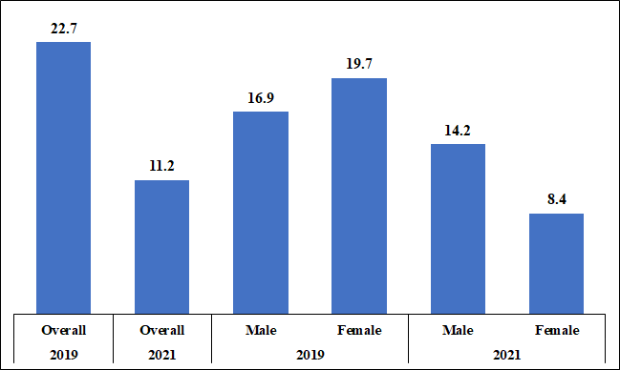
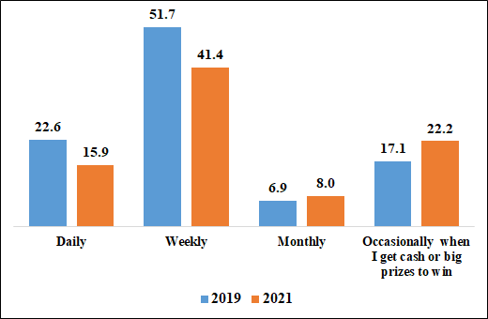
Those who perceive betting as a good source of income halved in 2021, a majority being female respondents…people also bet less frequently and amount per bet has reduced.
(a) Those Perceiving Betting a good source of income
(b): Frequency of betting

Slide 41
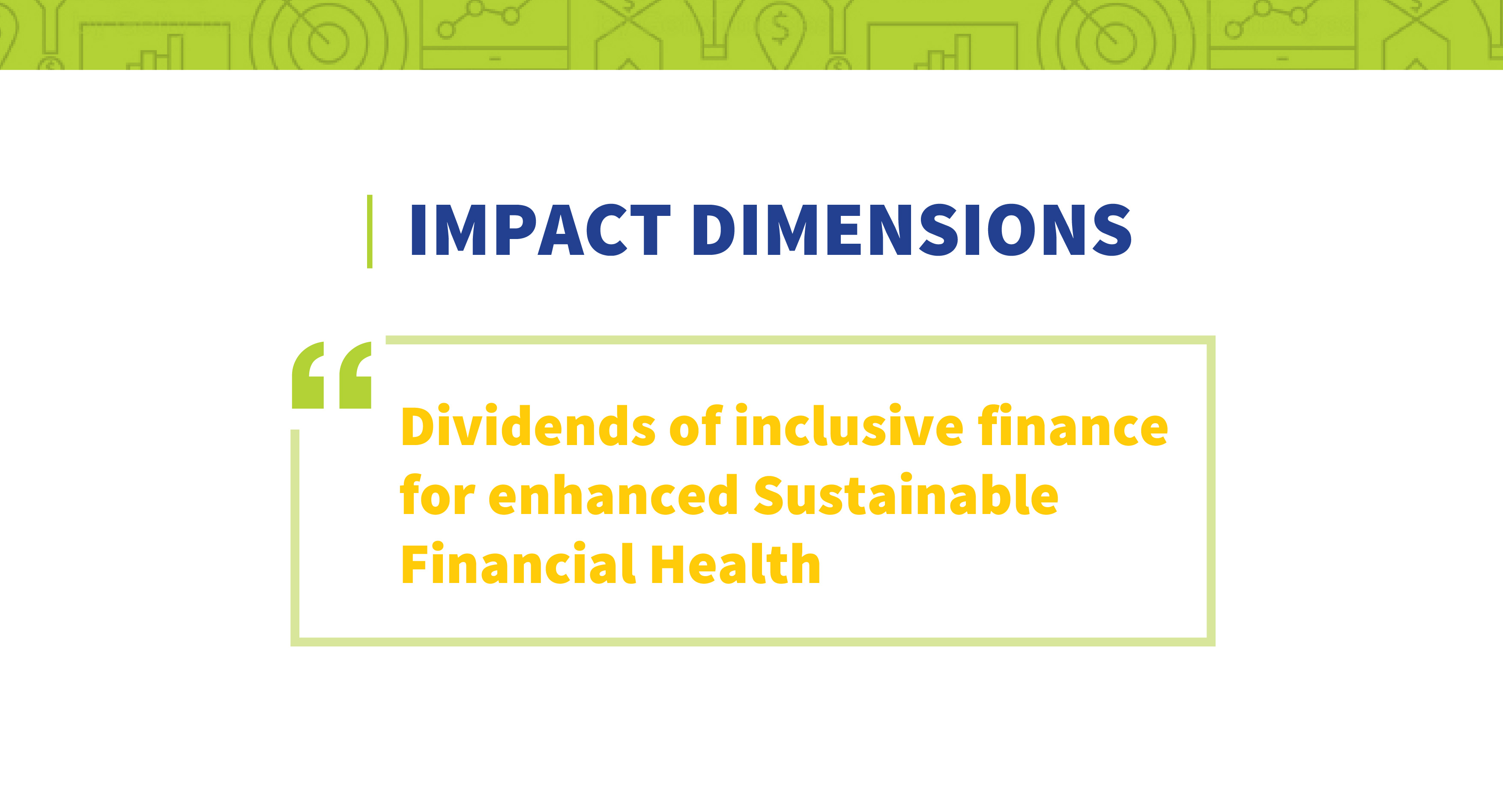
Impact dimensions
Dividends of inclusive finance for enhanced Sustainable Financial Health

Slide 42
Putting food on the table was a key life priority for Kenyans, with overall food vulnerability increasing in 2021 – 12% of respondents reported that they often slept without food in 2021
Life Goals
Food Vulnerability
Life priorities

Slide 43
The number of respondents who reported financial needs to deal with a shock increased 67.1% in 2021 from 36.2 % in 2019 – the main shock being health related
Financial needs

Slide 44
Use of formal solutions declined by almost half in meeting all 3 financial needs
Decline in use of informal solutions in dealing with day to day needs and shocks but increased for future investments
Meeting needs

Slide 45
Overall, financial health index declined in 2021compared to 2019, mainly on account of inability to meet day to day needs and coping with shocks. There is however optimism about investing more for their future.
Financial health and Optimism
Notes:
The financial health index across the population shows a marked decline since 2016.
This may be because of a general tightening of economic conditions for many- reflected also in a higher proportion who say their financial lives have worsened.
Statistical abstract (2018) also shows some indications of economic stress across different sectors as well as price increases in food and fuel…
The price index of food and non-alcoholic beverages increased by just under 16% from January 2016 to December 2017 (TABLE 3.20) This seems to have particularly affected low income urban dwellers with in increase in the price index for the low income population of Nairobi of just under 20%
The average price of petrol (super) increased by just under 11% from 2016 to 2017 (TABLE 3.21)
Public sector earnings growth from agriculture and forestry slowed to 1.5% between 2016 - 2017. The average year on year growth between 2013 and 2017 was 10.7% (TABLE 3.8)
Wage employment in private agriculture, forestry and fishing fell by around 1.6% (TABLE 3.3a)
0.6% year on year decrease in earnings in the public sector from manufacturing. This compares with an average year on year increase of 11.2% between 2013 - 2016

Slide 46
Summary and Conclusions
The 2021 FinAccess Survey provide very rich data and indicators for tracking developments in the financial inclusion space in terms of changing consumer behaviour, technological innovations, policy changes, demographic dynamics, entry of new players as well as globalization of economies.
Expanding the scope of the survey to all access, usage, quality and impact/welfare dimensions provide a holistic view to inclusive finance
We welcome more in-depth research from academia, development partners, private sector and policy makers in order to guide policy solutions, provide new knowledge and influence innovations that would benefit consumers

Slide 47
Thank You!

